Slide 1


Supporting Transition of Working Scientifically Skills from KS1-KS4
Katie Welch Lecturer in Primary Science
Robert Campbell Lecturer in Primary and Secondary Science
Developing the Hook!
@simmsprisci
@stmaryssecsci
@teachstmarys

Slide 2

A good science practical?
Think about is this a useful science experiment to promote learning? Why?
@simmsprisci
@stmaryssecsci
@teachstmarys

Slide 3
How do you promote scientific practical skills in your classroom? Share your ideas on vevox.app using the code on the board.

Slide 4

Feedback
This Photo by Unknown author is licensed under CC BY-SA-NC.

Slide 5
Working scientifically skills in the National Curriculum (DfE 2013)
asking relevant questions and using different types of scientific enquiries to answer them
setting up simple practical enquiries, comparative and fair tests
making systematic and careful observations and, where appropriate, taking accurate measurements using standard units, using a range of equipment, including thermometers and data loggers
gathering, recording, classifying and presenting data in a variety of ways to help in answering questions
recording findings using simple scientific language, drawings, labelled diagrams, keys, bar charts, and tables
reporting on findings from enquiries, including oral and written explanations, displays or presentations of results and conclusions
using results to draw simple conclusions, make predictions for new values, suggest improvements and raise further questions
identifying differences, similarities or changes related to simple scientific ideas and processes
using straightforward scientific evidence to answer questions or to support their findings.

Slide 6
Working scientifically skills
- Asking questions
- Observing and measuring
- Identifying and classifying (variables)
- Gathering and recording data
- Performing tests
- Using equipment
- Reporting, presenting and communicating data/findings (evaluation/analysis)
- Planning and setting up different types of scientific enquiries (prediction)
Working scientifically in the Primary Classroom: Progression of Enquiry Skills from EYFS to KS3
The Salter Institute

Slide 7
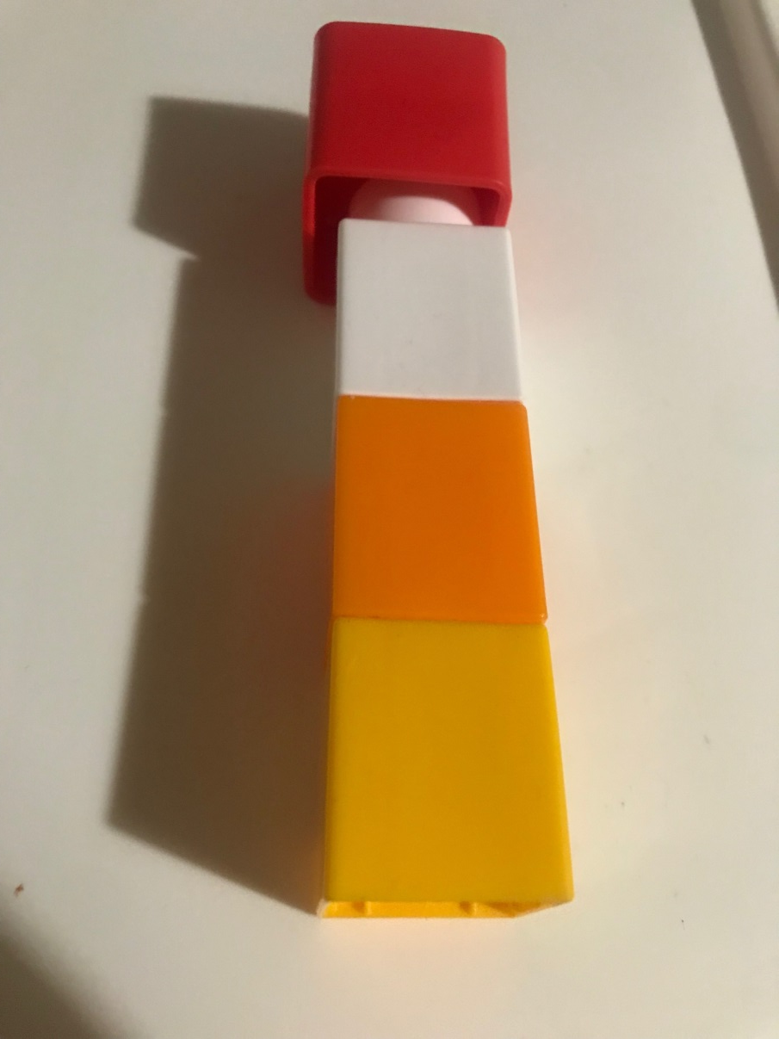
Working scientifically skills – transition from KS1 – KS4
Red = KS4
White = KS3
Orange = KS2
Yellow = KS1

Slide 8
The progression of skills looks like the following continuum:​
Teacher - led
Modelled Investigation
Semi - independence
Modelled Investigation
Independent
Carry out investigation
Use skills
Begin to use skills
@simmsprisci
@stmaryssecsci
@teachstmarys

Slide 9
However it is not so linear it is cyclical.
When a ‘new’ version of a skill is introduced e.g when drawing a line-graph (recording results) for the first time this will obviously be teacher-led (modelled) despite that the child might be capable of drawing their own tables (a different version of recording).
Teacher-led
Semi independent
Independent

Slide 10
Using graph drawing as an example:​
1. Please draw a graph of your results. Independent​
2.​ What measurements will you be using along the horizontal/vertical section of graph?​
What should we start and finish with?​ Semi – independent
3. Provide students with a graph already calibrated and they plot their answers​. Teacher - led

Slide 11
Task constructing questions and KS links
You have a series of example developing the hooks on the moodle page. Select the developing the hook entitled diffusing skittles.
You have been given the working scientifically vocabulary links for lower KS2 and upper KS2. What is expected of a KS3 student. Use the KS3 science national curriculum to help.
The plan has a question for lower key stage two and upper key stage 2. What would the question for key stage 3 look like?

Slide 12
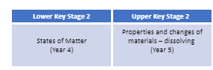
Developing the Hook! Diffusing skittles
Vocabulary
Working scientifically skills/questions: Interpreting results
LKS2 Can you see a pattern in your results.
UKS2 How does the temperature of the water affect the time the sweet takes to dissolve?
LKS2 | UKS2
I can spot patterns and refer to these when answering the questions, I set at the start of the experiment. | I can use data from primary and secondary sources to explain causal relationships
Science behind it.....​
The coloured dye in the skittles is soluble in water. The water molecules have kinetic energy. This causes the dye to move. The hot water has more kinetic energy and therefore the dye travels faster across the plate.
Method:
You will need:
4 x large plastic plates
1 x packet of skittles
Water at different temperatures
Stopwatch
Thermometer.
Place different coloured skittles around the edge of the plate.
Add 100ml of cold water in the centre of the plate
Time how long it takes for the dye to diffuse - to travel to the centre of the plate.
Repeat the experiment using different temperatures of water.
National Curriculum links:

